Slide 1
BIOSTATISTICAL LITERACY: What is it, and how can we teach it?
Featuring:
Michael Jiroutek
Laura Le
V.N. Vimal Rao
In collaboration with: Steve Foti (UFL) and Ann Brearley (UMN)
RSS Teaching Statistics Seminar Jan. 24, 2024
Notes:
Presenter: Laura
EDIT: Add affliation to our names…

Slide 2
GOAL of Seminar
To promote a course that
develops students’ abilities to
read, interpret, and evaluate
evidence from data.
Notes:
Presenter: Laura

Slide 3
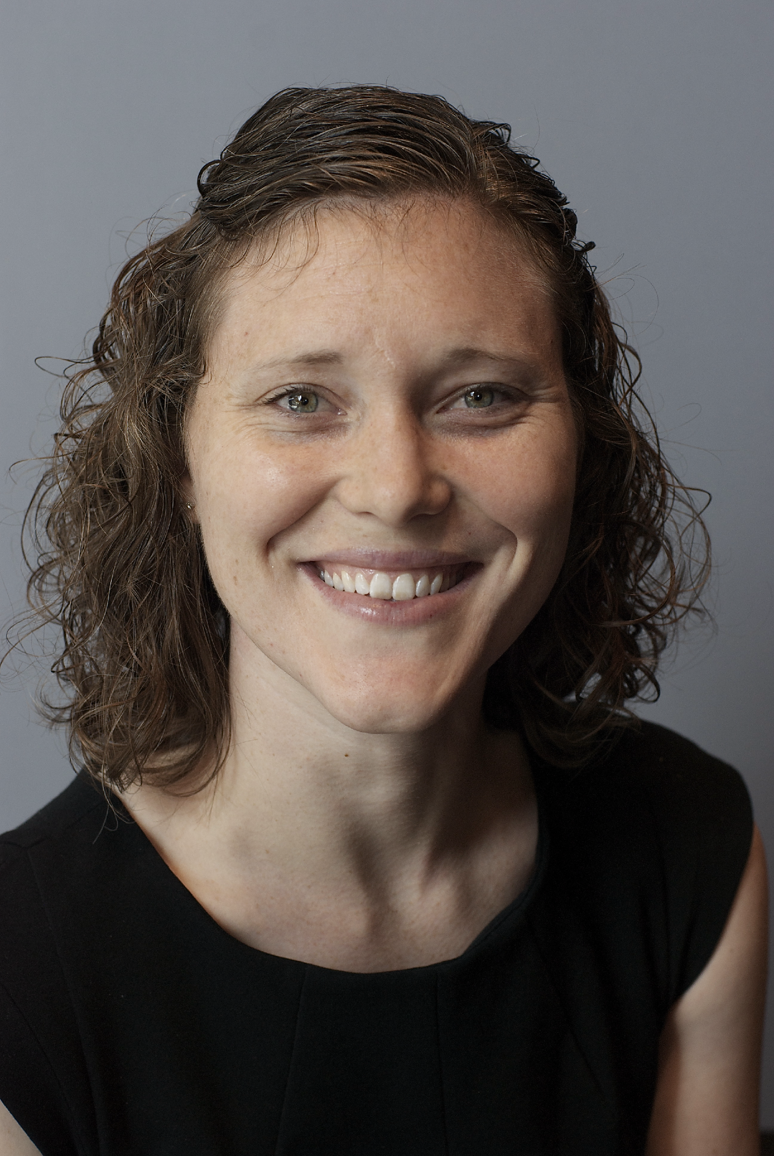







Michael Jiroutek
Laura Le
V.N. Vimal Rao
Class Format:
Online
Class Format:
In-person Online
Class Format:
Online
Class Size:
to
Class Size:
to
Class Size:
to
90
40
20
25
8
8
Student Background:
Clinical research master’s students
Student Background:
Public Health grad students
Health Science professionals (e.g., DNP, DVM, Dentists)
Student Background:
Public Health undergrad students
Active duty military

Slide 4
Michael Jiroutek
Laura Le
V.N. Vimal Rao
Class Format:
Online
Class Format:
In-person Online
Class Format:
Online
Class Size:
to
Class Size:
to
Class Size:
to
90
40
20
25
8
8
Student Background:
Clinical research master’s students
Student Background:
Public Health grad students
Health Science professionals (e.g., DNP, DVM, Dentists)
Student Background:
Public Health undergrad students
Active duty military

Slide 5
Michael Jiroutek
Laura Le
V.N. Vimal Rao
Class Format:
Online
Class Format:
In-person Online
Class Format:
Online
Class Size:
to
Class Size:
to
Class Size:
to
90
40
20
25
8
8
Student Background:
Clinical research master’s students
Student Background:
Public Health grad students
Health Science professionals (e.g., DNP, DVM, Dentists)
Student Background:
Public Health undergrad students
Active duty military

Slide 6


Warm-Up Questions
Question #1:
What is statistical literacy?
Question #2:
Who should have it?
Instructions:
Go to pollev.com/vimalrao182
If you get a page that says “Register for Credit”, click Skip for now
(optional) Enter name on Introduce yourself
Answer each question on the page, clicking Submit button when done
Notes:
Presenter: Vimal

Slide 7
What is statistical literacy? Who should have it?
Definition (Ziegler & Garfield, 2018):
Notes:
Presenter: Vimal

Slide 8

What is statistical literacy? Who should have it?
Definition (Ziegler & Garfield, 2018):
“The ability to read, understand, and communicate statistical information. This type of statistical information that is relevant for statistical literacy (e.g., graphical representations, descriptive statistics, inferential statistics) is encountered in daily life, such as in a media article, and involves real contexts”.
Notes:
Presenter: Vimal

Slide 9
What is statistical literacy? Who should have it?
Definition (Ziegler & Garfield, 2018):
“The ability to read, understand, and communicate statistical information. This type of statistical information that is relevant for statistical literacy (e.g., graphical representations, descriptive statistics, inferential statistics) is encountered in daily life, such as in a media article, and involves real contexts”.
Who: Anyone who consumes media (Everyone!)
Notes:
Presenter: Vimal

Slide 10
Identifying the Gaps
What’s missing?
Notes:
Presenter: Vimal
Our audience happens to be in health-science, but it applies to anyone where communication of data occurs.
Introductory (bio)statistics primarily are taught to future data consumers (versus producers). These courses often ask students to use software for data analysis, yet the vast majority of these students will never analyze data. We believe a literacy-focused course in (bio)statistics, anchored in reading and interpreting statistical results in research articles, better serves students who primarily need to evaluate evidence to communicate with data.

Slide 11
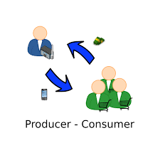
Identifying the Gaps
What’s missing?
Necessary skills, knowledge, and ability for graduate students who will be data consumers
Notes:
Presenter: Vimal
Our audience happens to be in health-science, but it applies to anyone where communication of data occurs.
Introductory (bio)statistics primarily are taught to future data consumers (versus producers). These courses often ask students to use software for data analysis, yet the vast majority of these students will never analyze data. We believe a literacy-focused course in (bio)statistics, anchored in reading and interpreting statistical results in research articles, better serves students who primarily need to evaluate evidence to communicate with data.

Slide 12
Identifying the Gaps
What’s missing?
Necessary skills, knowledge, and ability for graduate students who will be data consumers
What’s needed?
Notes:
Presenter: Vimal
Our audience happens to be in health-science, but it applies to anyone where communication of data occurs.
Introductory (bio)statistics primarily are taught to future data consumers (versus producers). These courses often ask students to use software for data analysis, yet the vast majority of these students will never analyze data. We believe a literacy-focused course in (bio)statistics, anchored in reading and interpreting statistical results in research articles, better serves students who primarily need to evaluate evidence to communicate with data.

Slide 13

Identifying the Gaps
What’s missing?
Necessary skills, knowledge, and ability for graduate students who will be data consumers
What’s needed?
To read, interpret, and evaluate statistical results in peer-reviewed papers and abstracts
Notes:
Presenter: Vimal
Our audience happens to be in health-science, but it applies to anyone where communication of data occurs.
Introductory (bio)statistics primarily are taught to future data consumers (versus producers). These courses often ask students to use software for data analysis, yet the vast majority of these students will never analyze data. We believe a literacy-focused course in (bio)statistics, anchored in reading and interpreting statistical results in research articles, better serves students who primarily need to evaluate evidence to communicate with data.

Slide 14
What is biostatistical literacy? Who should have it?
Definition: “The ability to read, understand, and communicate statistical information. This type of statistical information that is relevant for statistical literacy (e.g., graphical representations, descriptive statistics, inferential statistics) is encountered in daily life, such as in a media article, and involves real contexts”
(Ziegler & Garfield, 2018)
Notes:
Presenter: Vimal

Slide 15
What is biostatistical literacy? Who should have it?
Definition: “The ability to read, understand, and communicate biostatistical information. This type of statistical information that is relevant for biostatistical literacy (e.g., graphical representations, descriptive statistics, inferential statistics) is encountered in daily life, such as in a media article, and involves real contexts”
Notes:
Presenter: Vimal

Slide 16
What is biostatistical literacy? Who should have it?
Definition: “The ability to read, understand, and communicate biostatistical information. This type of statistical information that is relevant for biostatistical literacy (e.g., graphical representations, descriptive statistics, inferential statistics, and study design) is encountered in daily life, such as in a media article, and involves real contexts”
Notes:
Presenter: Vimal

Slide 17
What is biostatistical literacy? Who should have it?
Definition: “The ability to read, understand, and communicate biostatistical information. This type of statistical information that is relevant for biostatistical literacy (e.g., graphical representations, descriptive statistics, inferential statistics, and study design) is encountered in research and scholarship, such as in academic journals and conferences, and involves real contexts”
Notes:
Presenter: Vimal

Slide 18
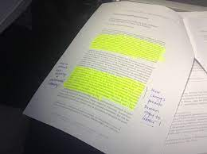
What is biostatistical literacy? Who should have it?
Definition: “The ability to read, understand, and communicate biostatistical information. This type of statistical information that is relevant for biostatistical literacy (e.g., graphical representations, descriptive statistics, inferential statistics, and study design) is encountered in research and scholarship, such as in academic journals and conferences, and involves real contexts”
Who: Anyone who professionally consumes health-related information
Notes:
Presenter: Vimal

Slide 19


Course Objective
Biostatistical Literacy has the primary goal of developing students’ ability to read and interpret statistical results in the primary literature of their specific scientific field of interest.
Includes
Does Not Include
Critically reading research articles
Interpreting results
Calculations (VERY minimal)
Statistical programming software (No!)
Notes:
Presenter: Mike

Slide 20
What is Biostatistics?
Branch of statistics that deals with data from biology, public health, Medicine, and other health sciences.
Examples:
•Identifying risk factors associated with a disease or condition
•Evaluating the effectiveness of interventions on a disease or condition
•Predicting disease or condition outcomes based on risk factors
Notes:
Presenter: Mike

Slide 21
Overview of Biostatistical Literacy Course
Intro to Biostatistics
Intro to Survival Data
CI for a Proportion
Summarizing Continuous Variables
CI for a Mean
Challenges in Statistics
Tests for Comparing Risks/Odds
Hypothesis Testing
Tests for Comparing Means/Hazards
Communicating Risk
ANOVA
Correlation & Regression
Multiple Linear Regression
Logistic and Proportional Hazards Regression
Notes:
Presenter: Mike

Slide 22
Overview of Biostatistical Literacy Course
UNIT TIMELINE
Preparation
Active Learning
Assessment
Read textbook and view online presentations
Complete Readiness Quiz
Concept Activity & Collaborative Key
Literature Activity & Collaborative Key
Complete End-of-Unit Assessment
Early in Unit
Middle of Unit
End of Unit
Notes:
Presenter: Mike

Slide 23
Example Unit: Introduction to Survival Data
Intro to Biostatistics
Intro to Survival Data
Preparation
Active Learning
Assessment
Read textbook and view online presentations
Complete Readiness Quiz
Concept Activity
Literature Activity
Complete End-of-Unit Assessment
Collaborative Keys
Early in Unit
Middle of Unit
End of Unit
Notes:
Presenter: Mike
Lead attendees through what a “unit” looks like (learning objectives; example items on each activity; what are collaborative keys; end-of-unit quiz)

Slide 24
Intro to Survival Data: Learning Objectives
Use these learning objectives as a checklist during the unit. After completing this unit, you should be able to:
explain what constitutes an “event”.
give examples of censored data.
identify starting date (i.e., “time zero”) for study participants.
identify summary measures of survival data analysis, such as median survival time and five-year
survival rate.
interpret a Kaplan-Meier survival curve, specifically:
o know what is on the x- and y-axes,
o know why the curve has steps,
o know what the curve tells you,
o be aware that censoring is taken into account in constructing the curve, and
o be able to indicate censoring on the curve.
Notes:
Presenter: Mike

Slide 25


Preparation
Intro to Survival Data: Preparation
Active Learning
Assessment
Read textbook and view online presentations
1 to 4 chapters of Intuitive Biostatistics (by Harvey Motulsky, 2018, 4th ed.)
1 to 3 recorded presentations
Complete Readiness Quiz
Formative assessments to help students check their understanding WHILE they are still learning
All multiple-choice or true-false question format
Low stakes, multiple attempts
Notes:
Presenter: Mike

Slide 26
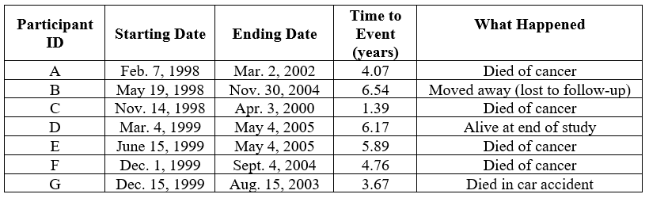
Preparation
Intro to Survival Data: Concept Activity
Active Learning
Assessment
Goal: To understand how to properly account for censoring when estimating survival and what a Kaplan-Meier curve tells you.
Use small, imaginary cancer treatment study example (from textbook):
Notes:
Presenter: Laura

Slide 27

Preparation
Intro to Survival Data: Concept Activity
Active Learning
Assessment
Activity: Provide step-by-step instructions for how to construct a survival curve with and without censoring to investigate impact.
Example Questions
 | What is the event of interest?
 | What are some ways we can summarize or describe survival data?
 | Why is it important to include the censored data when carrying out survival data analysis?
 | Suppose your colleague needs help interpreting a Kaplan-Meier curve. How might you describe the characteristics and features of the curve?
 | Think of an example in your field of a time-to-event situation (that is not time-to-death). Be sure to specify what the event is.
Notes:
Presenter: Laura
Why did the four of us force you to do this for 30 mins? We think going through concept is important before application. Solidify foundational knowledge. Learning theory/framework? Bloom’s Taxonomy + Vygotsky’s scaffolding + Johnson Brothers’ Cooperative Learning
Asking follow-up questions. Do they understand the concepts?
You can do this in person, or if you’re online, do this in the CK.

Slide 28


Preparation
Intro to Survival Data: Literature Activity
Active Learning
Assessment
Goal: To practice interpreting the results of survival analyses in the literature.
Literature Article
Notes:
Presenter: Laura

Slide 29
Preparation
Intro to Survival Data: Literature Activity
Active Learning
Assessment
Example Questions (General)
 | What is the authors’ primary research question/finding?
 | What sampling method and study design was used for this study?
 | What is the purpose of random assignment?
 | Do you think the comparison that the researchers did made sense or was appropriate? Why do you think they made this comparison?
 | What are some of the strengths/limitations of this study?
 | How qualified and reputable are the authors? Are there any potential conflicts of interest? What is the rank of the journal among journals in this field?
Notes:
Presenter: Laura

Slide 30
Preparation
Intro to Survival Data: Literature Activity
Active Learning
Assessment
Example Questions (Topic-related)
 | How is the event of interest defined? Where in the article does it say this?
 | How is time zero defined (e.g., starting date)?
 | How could a participant be censored in this study?
 | Examining the Kaplan-Meier curve, what do the two curves represent? Why do the curves not drop to 0% by the end? Which group has the best survival? Which group has the worst? Is there evidence of a difference between the two groups?
 | What is the estimated median survival time for a particular group?
 | What is the estimated 8-year survival for a particular group?
Notes:
Presenter: Laura
Students go through at least 14 lit articles in this classroom. They get really good by the end at not just skipping methods and results. They learn how to READ! “I always used to skip the methods and the results but now I can read them” “I always looked at tables and my eyes glazed but now I can read them” “I really love the article critique project and now i’m going to use it for a journal club” “I can see clearly now the biostatistics illiteracy is gone”
We’re not just teaching random pieces of knowledge, we’re teaching people how to read science, cuz they’re scientists, and they need to know how to read.
Continuously reinforces topics: elaborative rehearsal, memory and reinforcement, spaced practice.
Curriculum is a spiral. Survival data is introduced early, but keep comings up. Spaced/distributed practice. This works. Learning theories!

Slide 31
Activities + Collaborative Keys
Preparation
Active Learning
Assessment
Students also work collaboratively as a class to create the “answer keys” for the activities via Google Documents.
Student Engagement
Instructor Engagement
Instructor Engagement:
Teaching team [instructor(s), TAs] monitor the documents.
Activities
Activities: Students work independently or in groups
Notes:
Presenter: Laura
If you have activities in your class (whether in-person or online), consider creating something we call collaborative keys, which are essentially answer keys but are created by the students in the class instead of by the teaching team and handed out to students.
I’ll describe first what it is and then talk about the benefits and challenges.

Slide 32
Contributions to Collaborative Keys
Preparation
Active Learning
Assessment
Ways to Contribute
If blank, post an answer to a question.
If a question has a correct answer, but you think there are alternative correct answers, add your alternative.
If a question has an answer, but you think it is incorrect, add a comment and/or post what you think is the correct answer.
If a question has an answer, but you think the concept is confusing or needs additional explanation, ask a question OR provide a clearer explanation.
Post any additional thoughts you had while answering the question.
Answer additional questions posed by the instructor or TAs.
Notes:
Presenter: Laura
Students receive participation points for contributing at least once to the collaborative key. So we don’t assign students to questions and let them choose which questions to answer (more on varieties of this later). We tell them the ways to contribute include...

Slide 33

Collaborative Keys In Action
Notes:
Presenter: Laura

Slide 34
Collaborative Keys: Benefits and Challenges
Preparation
Active Learning
Assessment
Benefits
Flexible, easy to implement
Low stakes
Quick feedback
Less time for faculty
Cooperative learning techniques
Builds learning community
...and more!
Challenges
Quality of answers
Buy in (engagement) from students
Overambitious students
Notes:
Presenter: Laura
Flexible, easy to implement (ideal for active learning or flipped classes)
Low stakes (so aren’t afraid to say “i don’t understand this question” or provide an incorrect answer)
Quick feedback (looked at daily by teaching team, but also gets feedback from their peers)
Less time for faculty (potentially more activities...less lecturing; less grading)
Cooperative learning techniques (positive interdependence yet individual and group accountability); is a surrogate for the in-person discussions in an online course
Builds a learning community (there are discussions among the students, students helping other students out, questions being asked that are beyond the question that is asked, etc.)
I stopped getting asked “can i have the answer key?” to the in-person activities.
More (encourages critical thinking, puts the responsibility of learning on the student while getting support from the teaching team,
Collaborative keys feel like a more natural way of engaging with one another in a virtual setting (over the “post twice, first an original response and then reply to a peer” approach, which IMO feels unnatural way of interacting). You have an activity to help with your learning, and you want answers to the activity, so why not work together as a class to create the answers?
Quality in answers (you will still get those that put in bare minimum and not provide quality of answers; you could possibly set expectations on what classifies as participation and enforce it; what i’ve heard from students is you get as much out of the collaborative keys as you put in, so for those that don’t put in effort on something that’s a learning opportunity,...)
Buy in (engagement) from students (similar to above; buy in from in-person students so might have to make tweaks to make it work for different cohorts of students; same course, different set of students)
Overambitious students (students who answer first for many questions; just need to set reminders about ways to contribute)

Slide 35
Intro to Survival Data: Assessment
Preparation
Active Learning
Assessment
Complete End-of-Unit Assessment
Summative assessments to help students evaluate their understanding at the END of the unit
All open-ended (short answer) question format (1-3 sentences, max)
8-10 questions
“Higher” stakes than Readiness Quiz (but still low stakes on the whole), one attempt
Notes:
Presenter: Mike
Focused on unit objectives; Better learning experience/knowledge evaluation having to write own; answers more informative than selecting amongst ones I’ve written as multiple choice; Length limit forces careful consideration, doesn’t allow ‘student; rambling technique’ and mimics word limits in abstracts, etc.; Allows for incorporation of AI if desired

Slide 36
Intro to Survival Data: Assessment
Preparation
Active Learning
Assessment
Provide real study abstract (slightly edited)
Present Kaplan-Meier plot (from same study)
Identify the event of interest in this study.
What defines the starting date or time zero for a participant in this study?
Give one possible reason why a participant’s observation in this study might be censored
What is the estimated <time-X> survival for those in <group A>? Explain how you arrived at your answer.
What is the estimated median survival time for those in <group B>? Explain how you arrived at your answer.
Notes:
Presenter: Mike

Slide 37



Conclusions
Biostatistical Literacy course offers a (flexible) approach for teaching students how to read and interpret statistical results in the research literature.
Different disciplines (e.g., swap out an article/context but use similar questions)
Course formats (in-person, hybrid, fully online)
Student populations
Notes:
Presenter: Vimal
And then what?? Biostat Literacy 2 course, “Producer” course
Emphasize all the manners in which we teach, all the students, all the formats, all the things.

Slide 38
References
Brearley, A. M., Rott, K. W., & Le, L. J. (2023). A biostatistical literacy course: Teaching medical and public health professionals to read and interpret statistics in the published Literature. Journal of Statistics and Data Science Education.
Motulsky, H. (2018). Intuitive biostatistics: a nonmathematical guide to statistical thinking. Oxford University Press, USA.
Ziegler, L., & Garfield, J. (2018). Developing a statistical literacy assessment for the modern introductory statistics course. Statistics Education Research Journal, 17(2), 161-178.

Slide 39
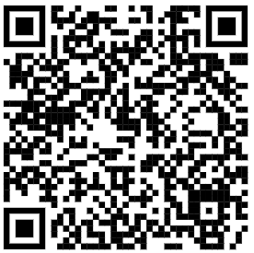
Thank You!
RaoVNV.github.io/BiostatLiteracyProject
Michael R. Jiroutek
jiroutekm@campbell.edu
Laura Le
free0312@umn.edu
V.N. Vimal Rao
raovnv@illinois.edu
RSS Teaching Statistics Seminar Jan. 24, 2024
Notes:
Presenter: Vimal

